Slide 1
AutoML
PyCaret vs Auto Gluon vs Auto Keras Feb 2024

Slide 2
Core Processes
Finetuning
Operationalization
Automation
ML Lifecycle
Experiment Tracking
Architecture Design
MLOps Fundamentals
Deployment scenarios
Modularization
Model Drift
MLOps Level 1
Infrastructure management
ML Pipelines
AutoML
MLOps Level 2
Data and Model Versioning
Conteinarization

Slide 3
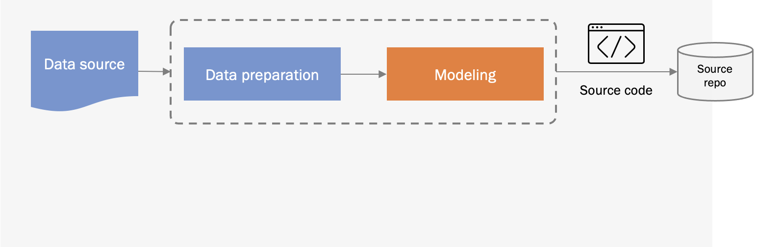
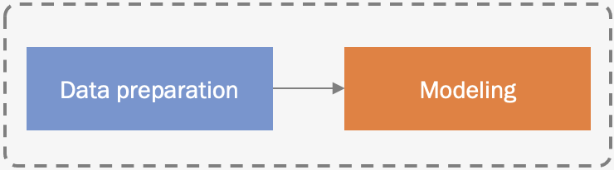

Model experimentation and development
CI/CD
Pipeline building and testing
Packages
CD Pipeline Deployment
Feature store
Model update cycle
Model serving
Continuous Deployment (CD)
Model repo
Training
Validation
Data validation
Data preparation
Model serving
Scaling
Logging
Monitoring
Trigger
Model monitoring
Model API
Live data

Slide 4


Slide 5
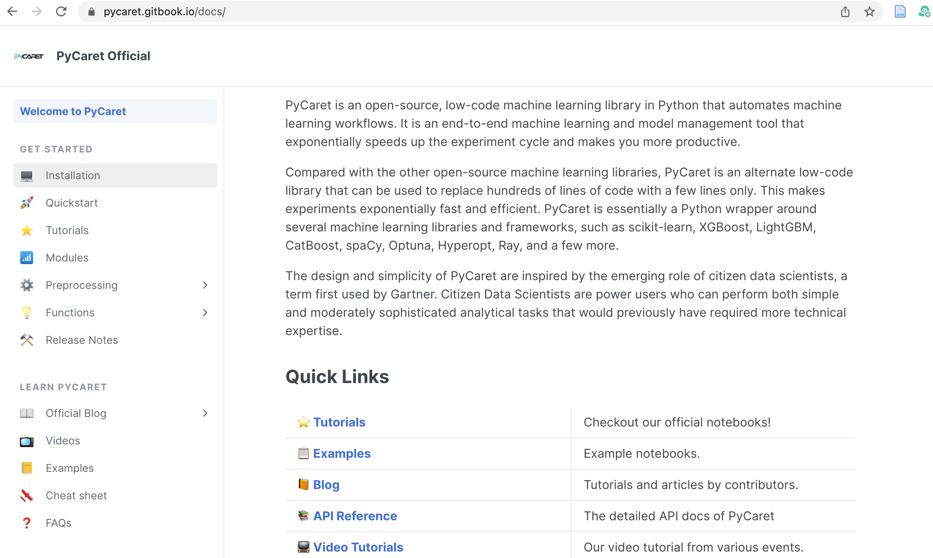

Slide 6
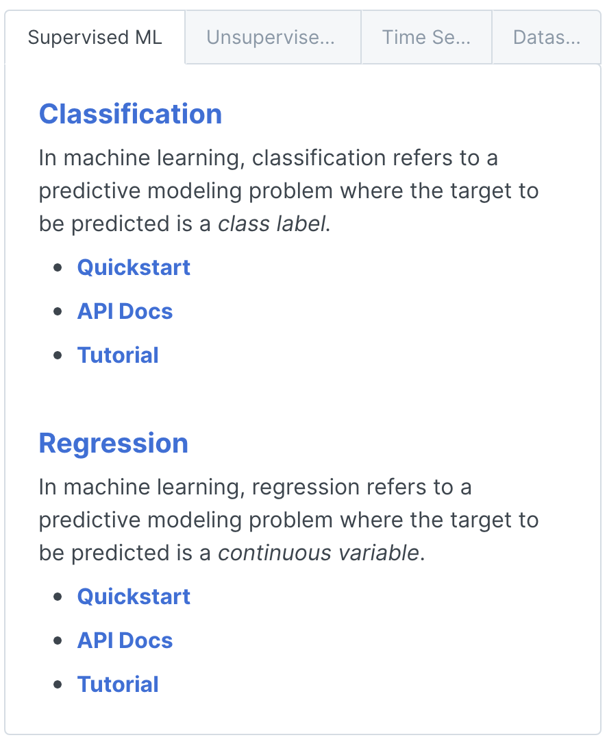
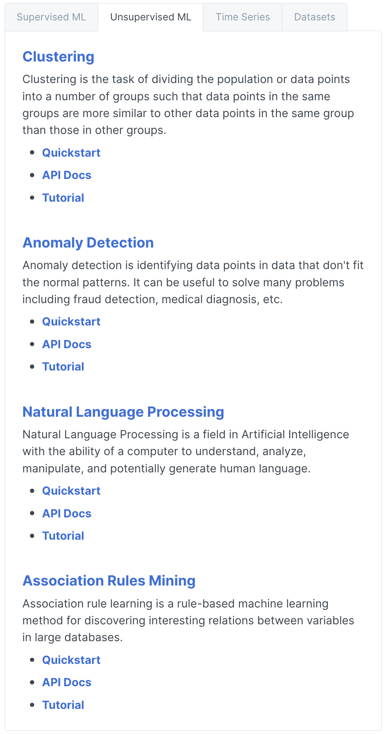
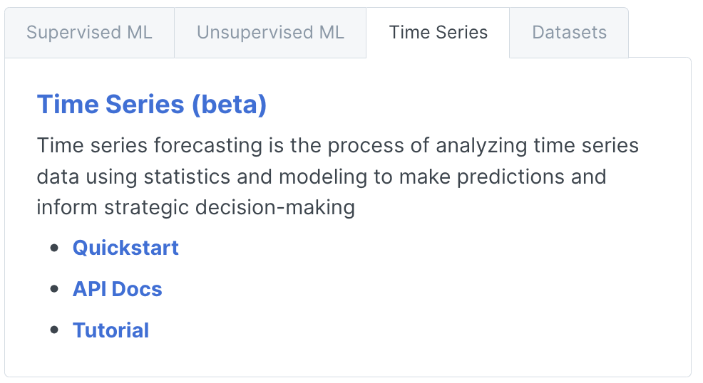

Slide 7
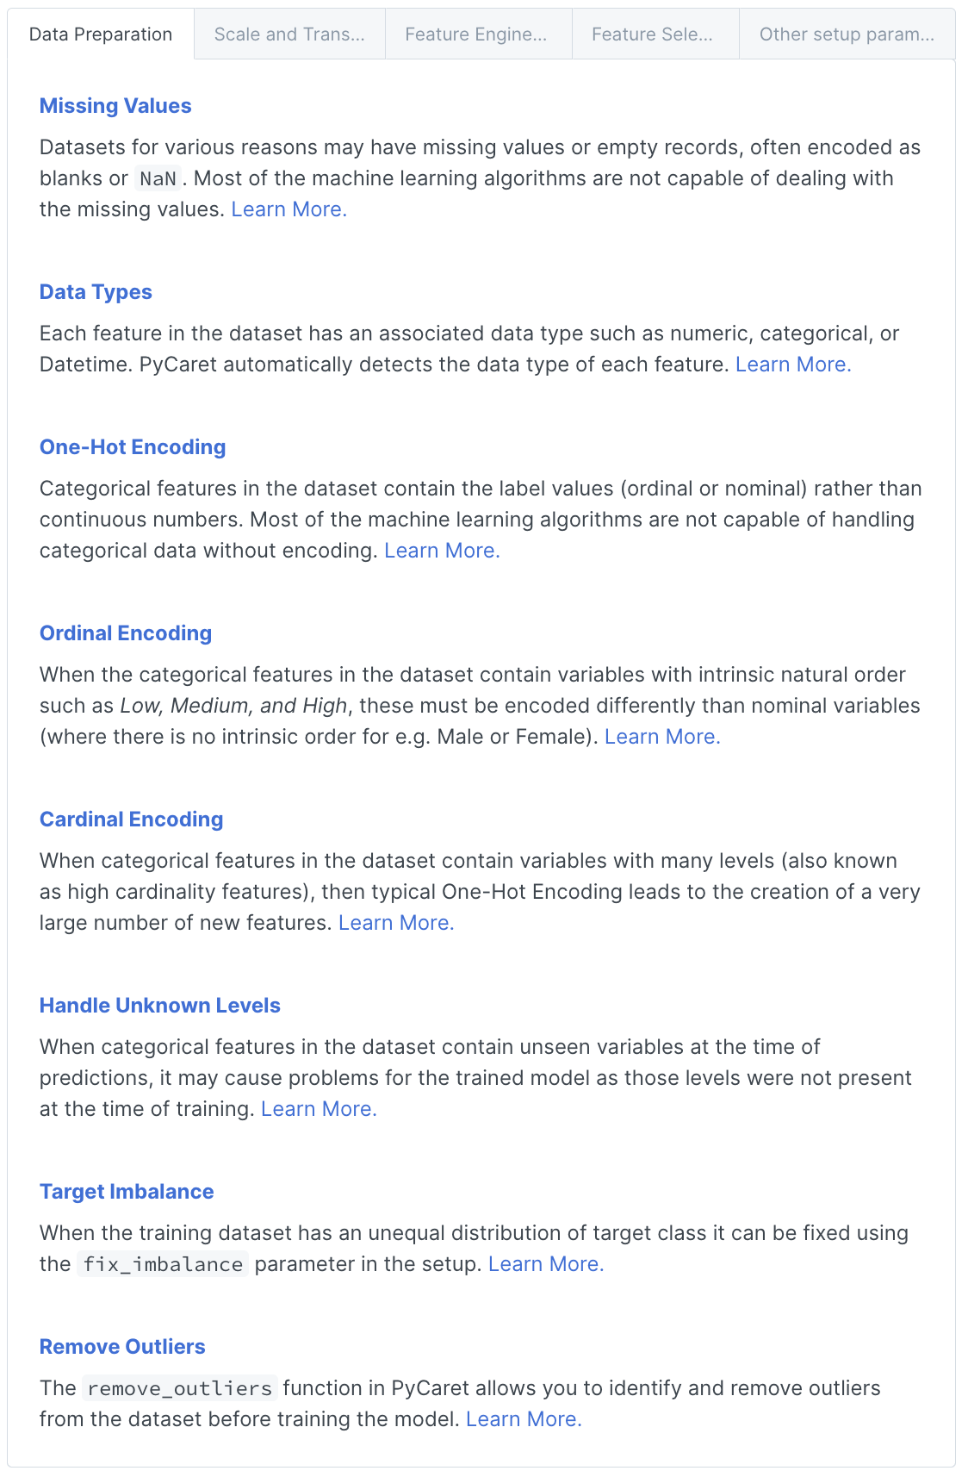
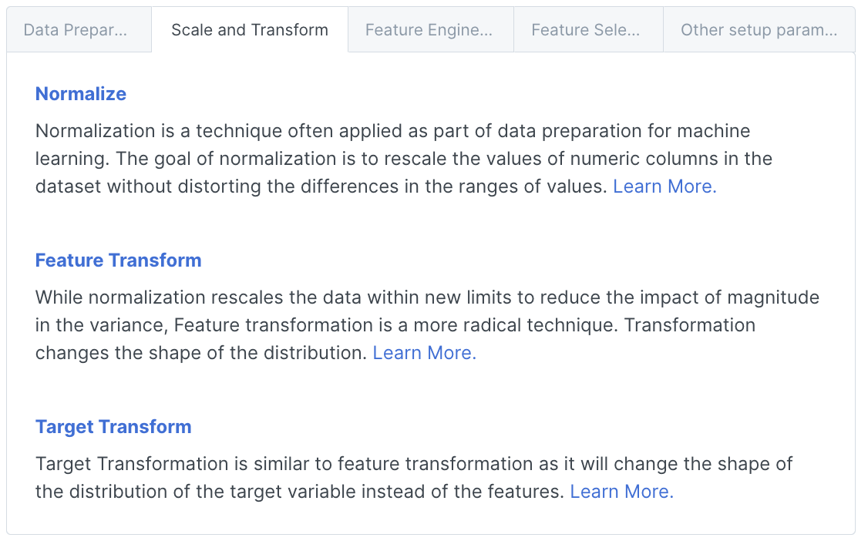
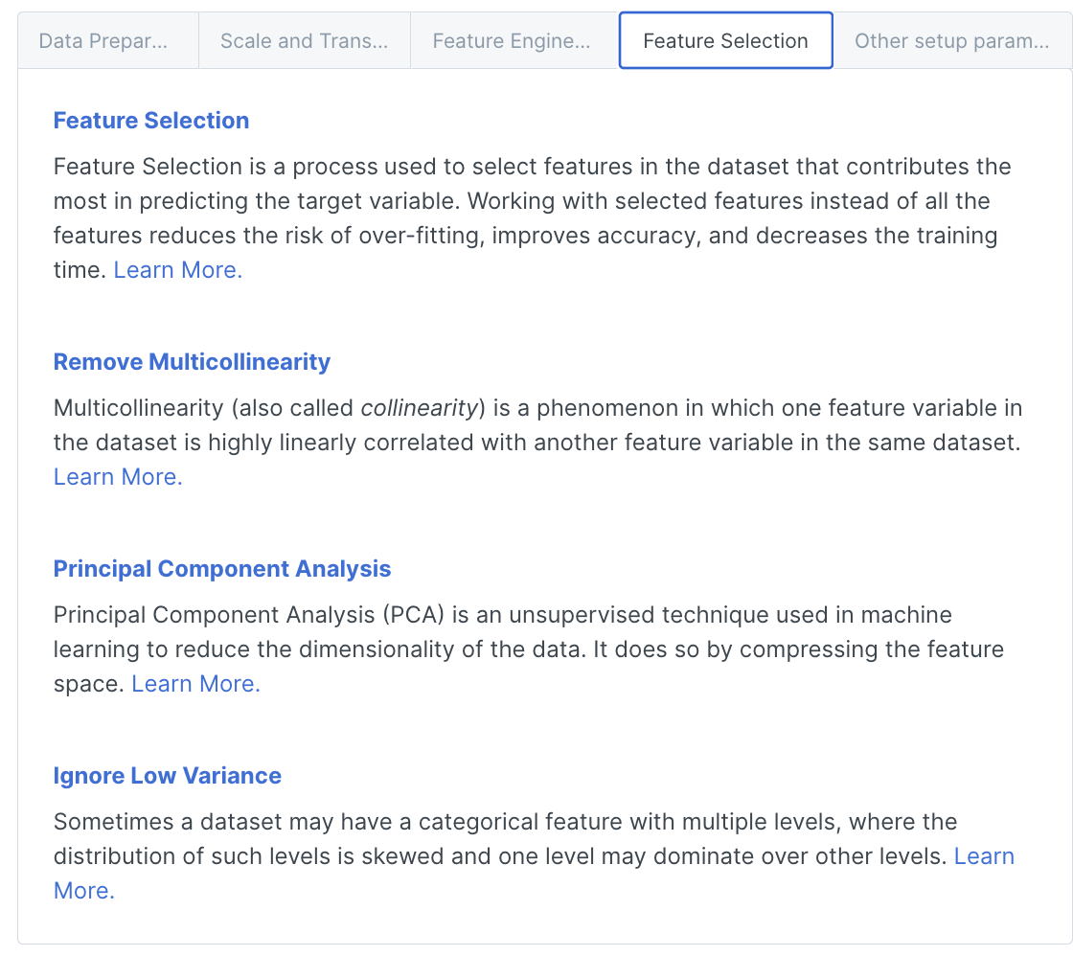
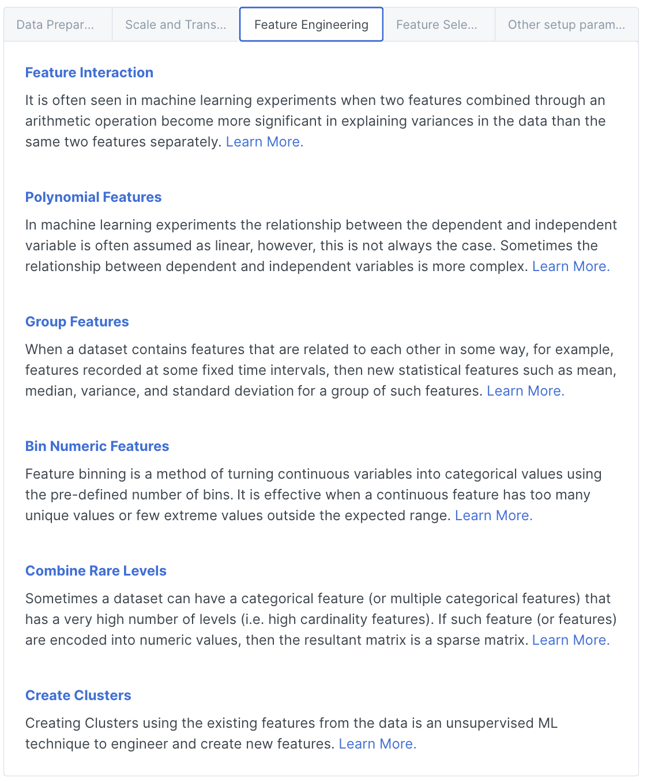

Slide 8
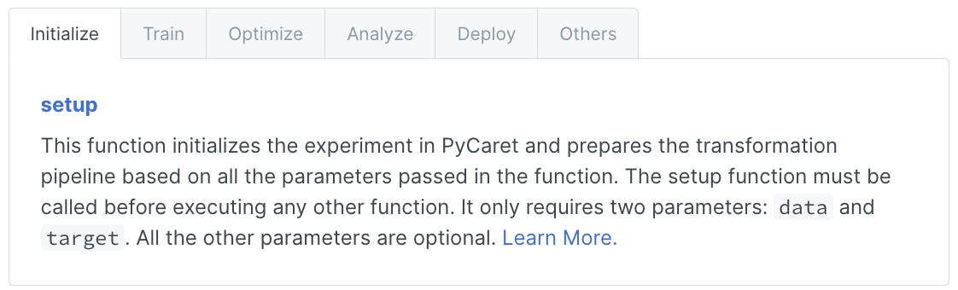
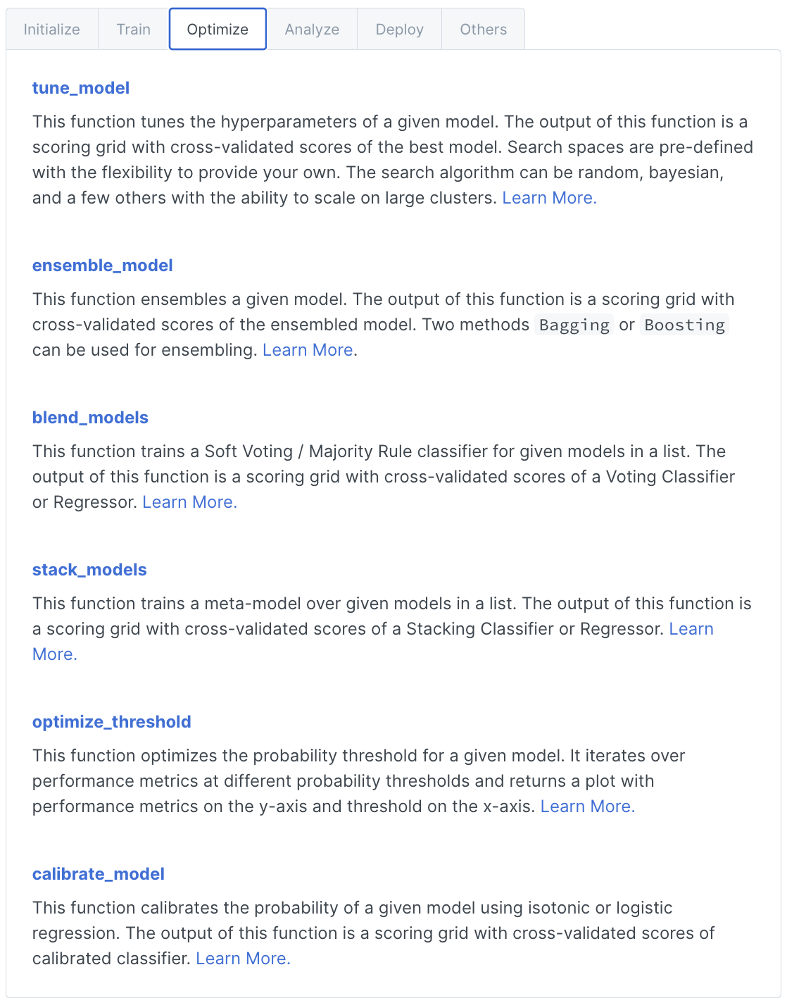
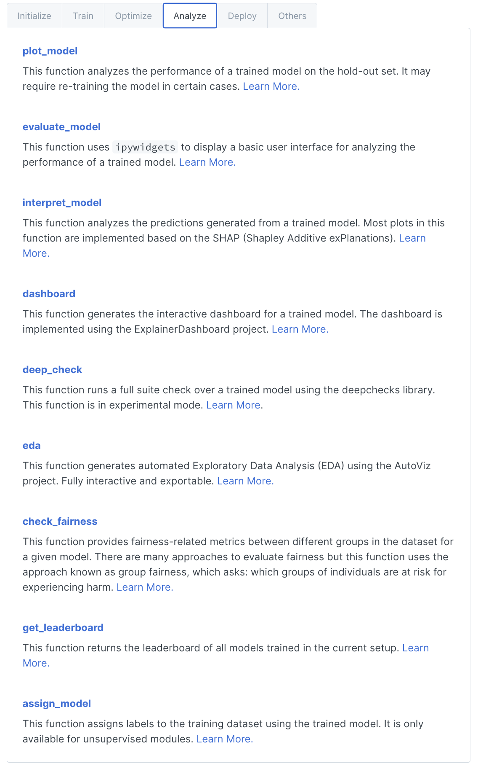
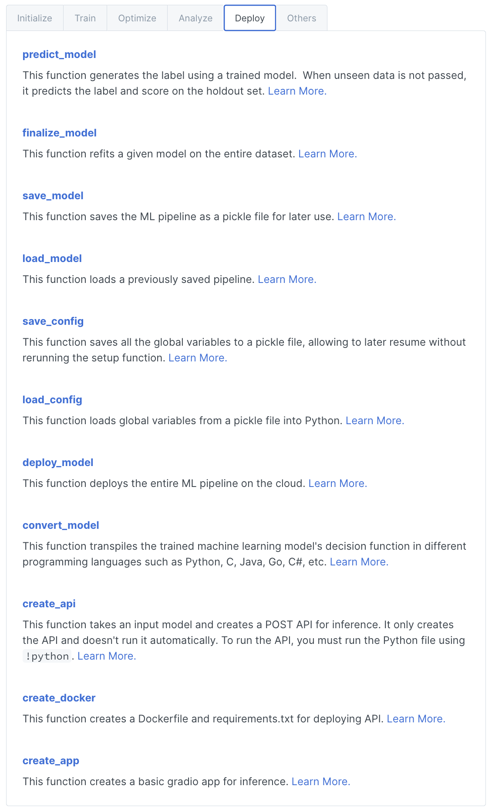
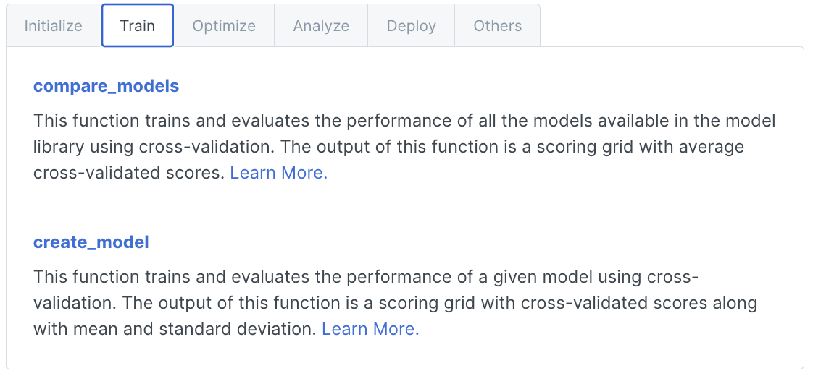

Slide 9


Slide 10
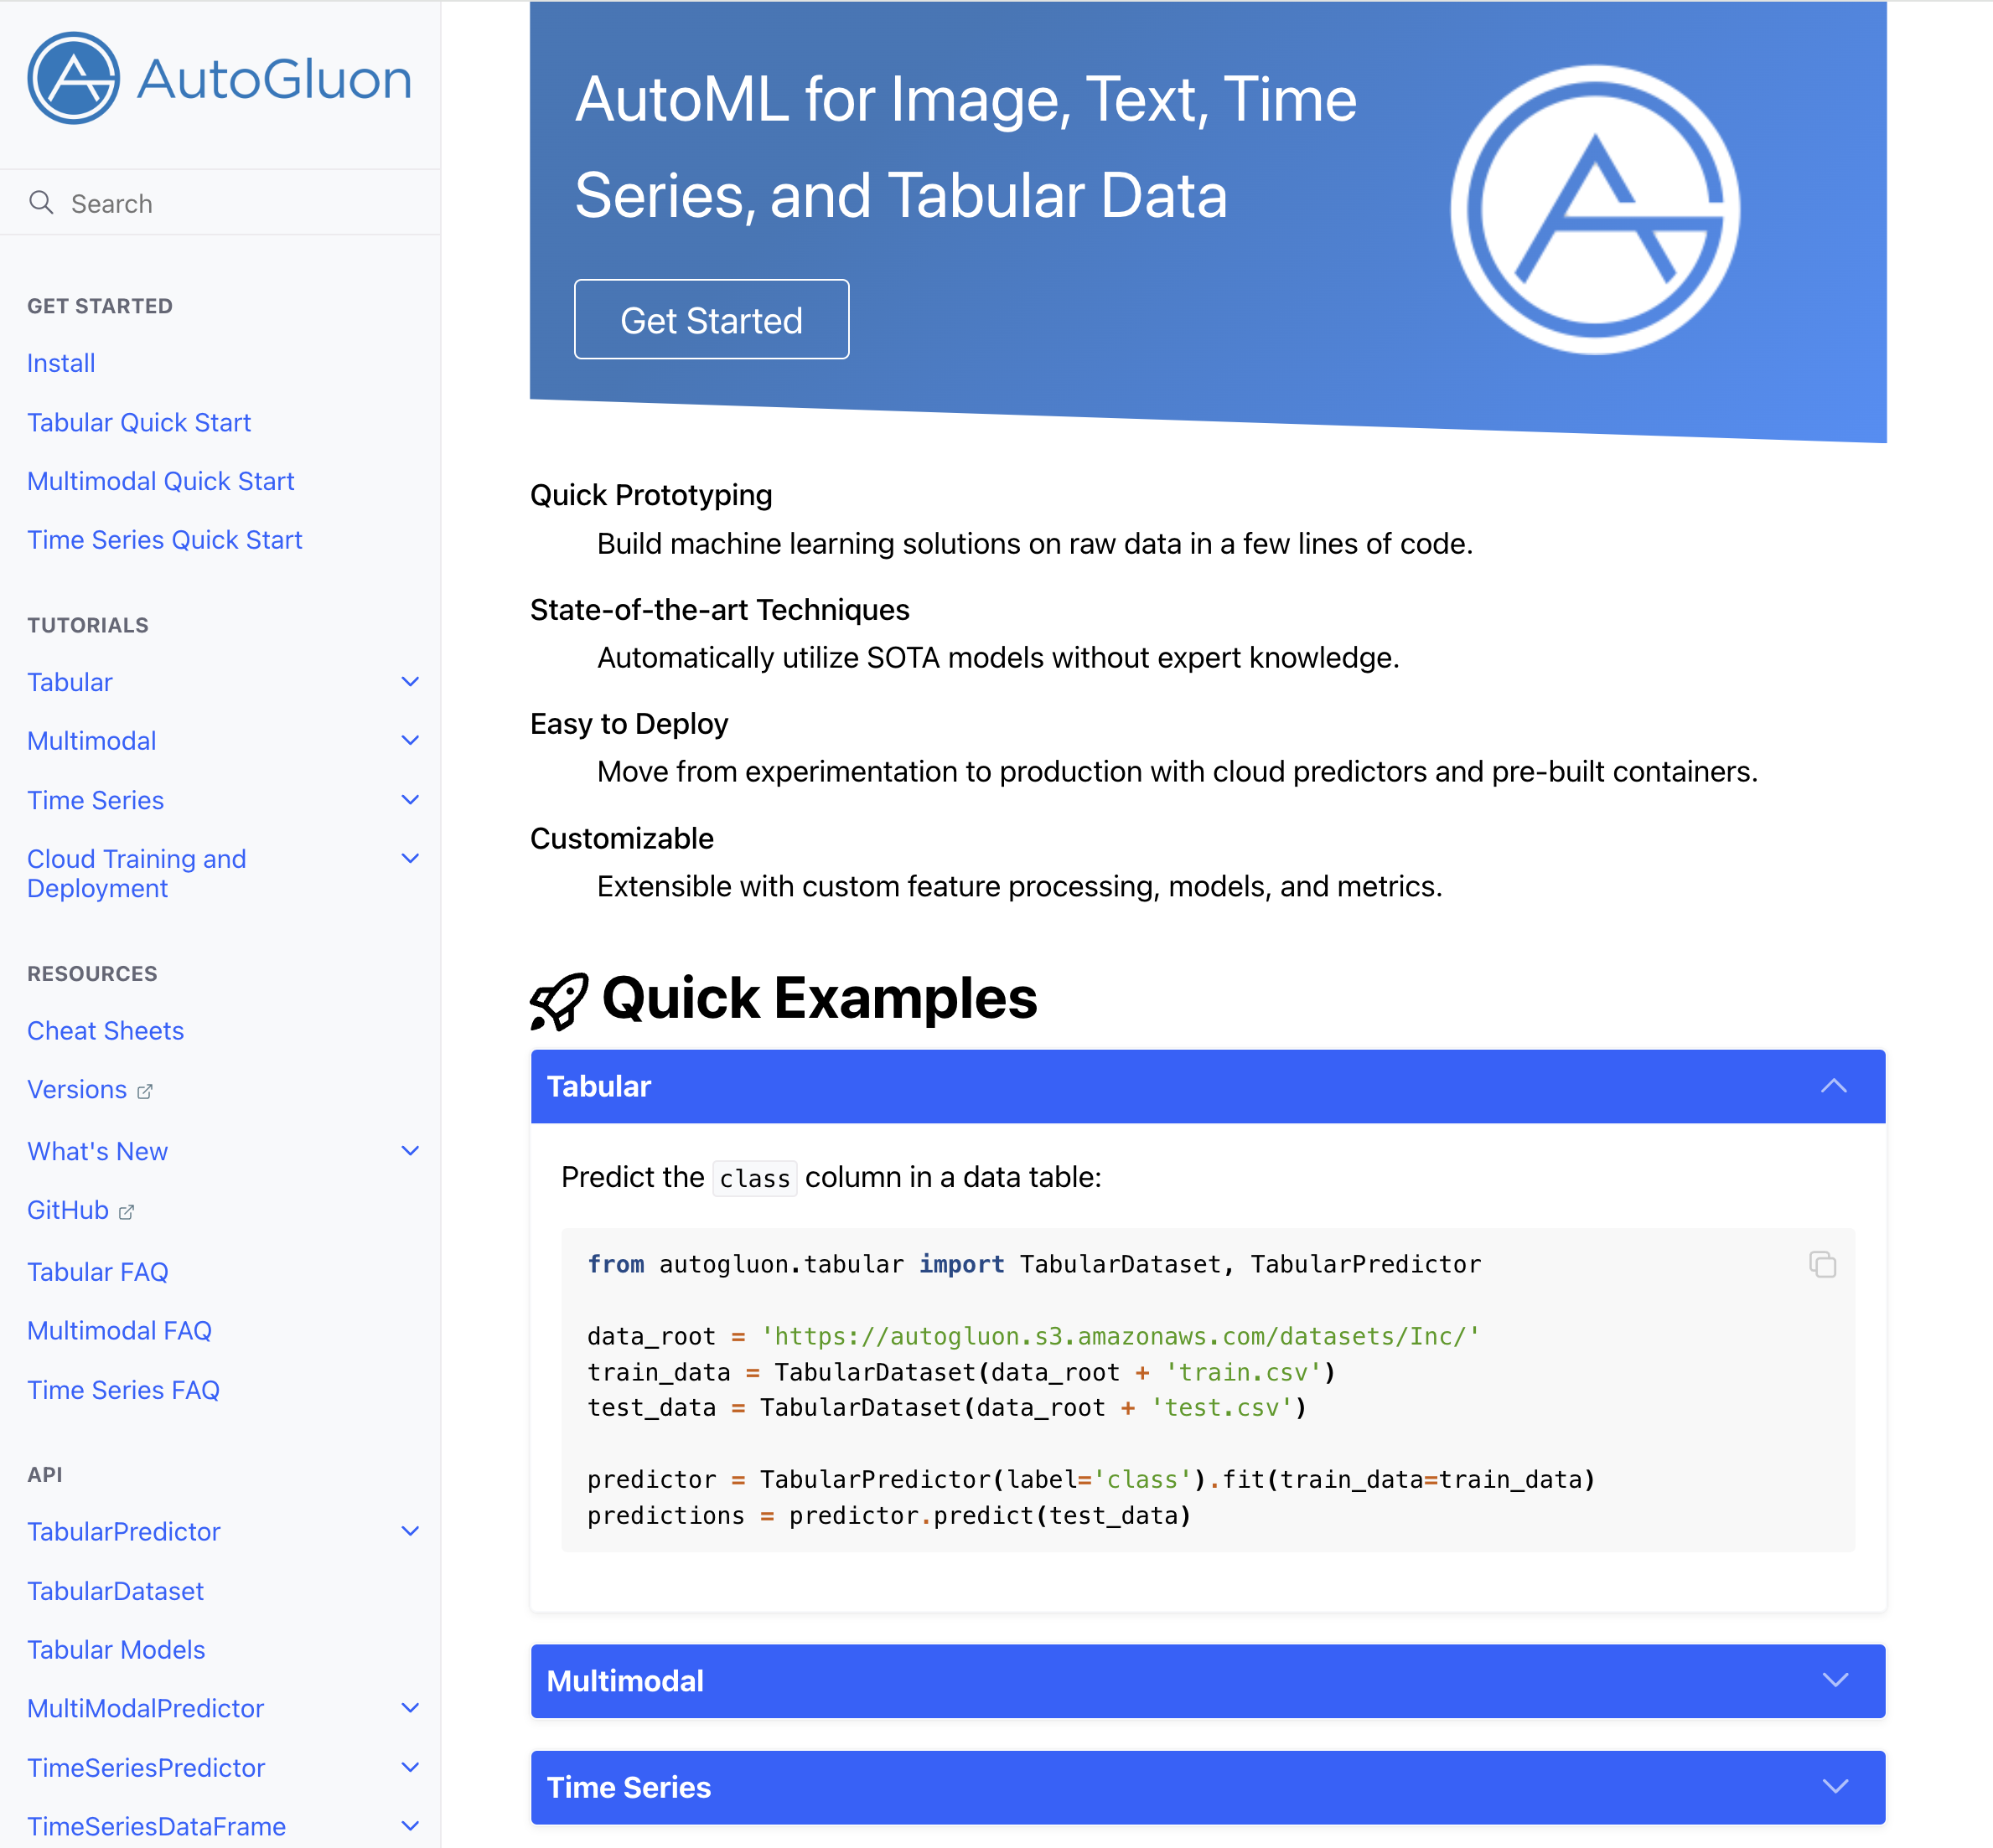

Slide 11
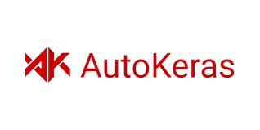

Slide 12
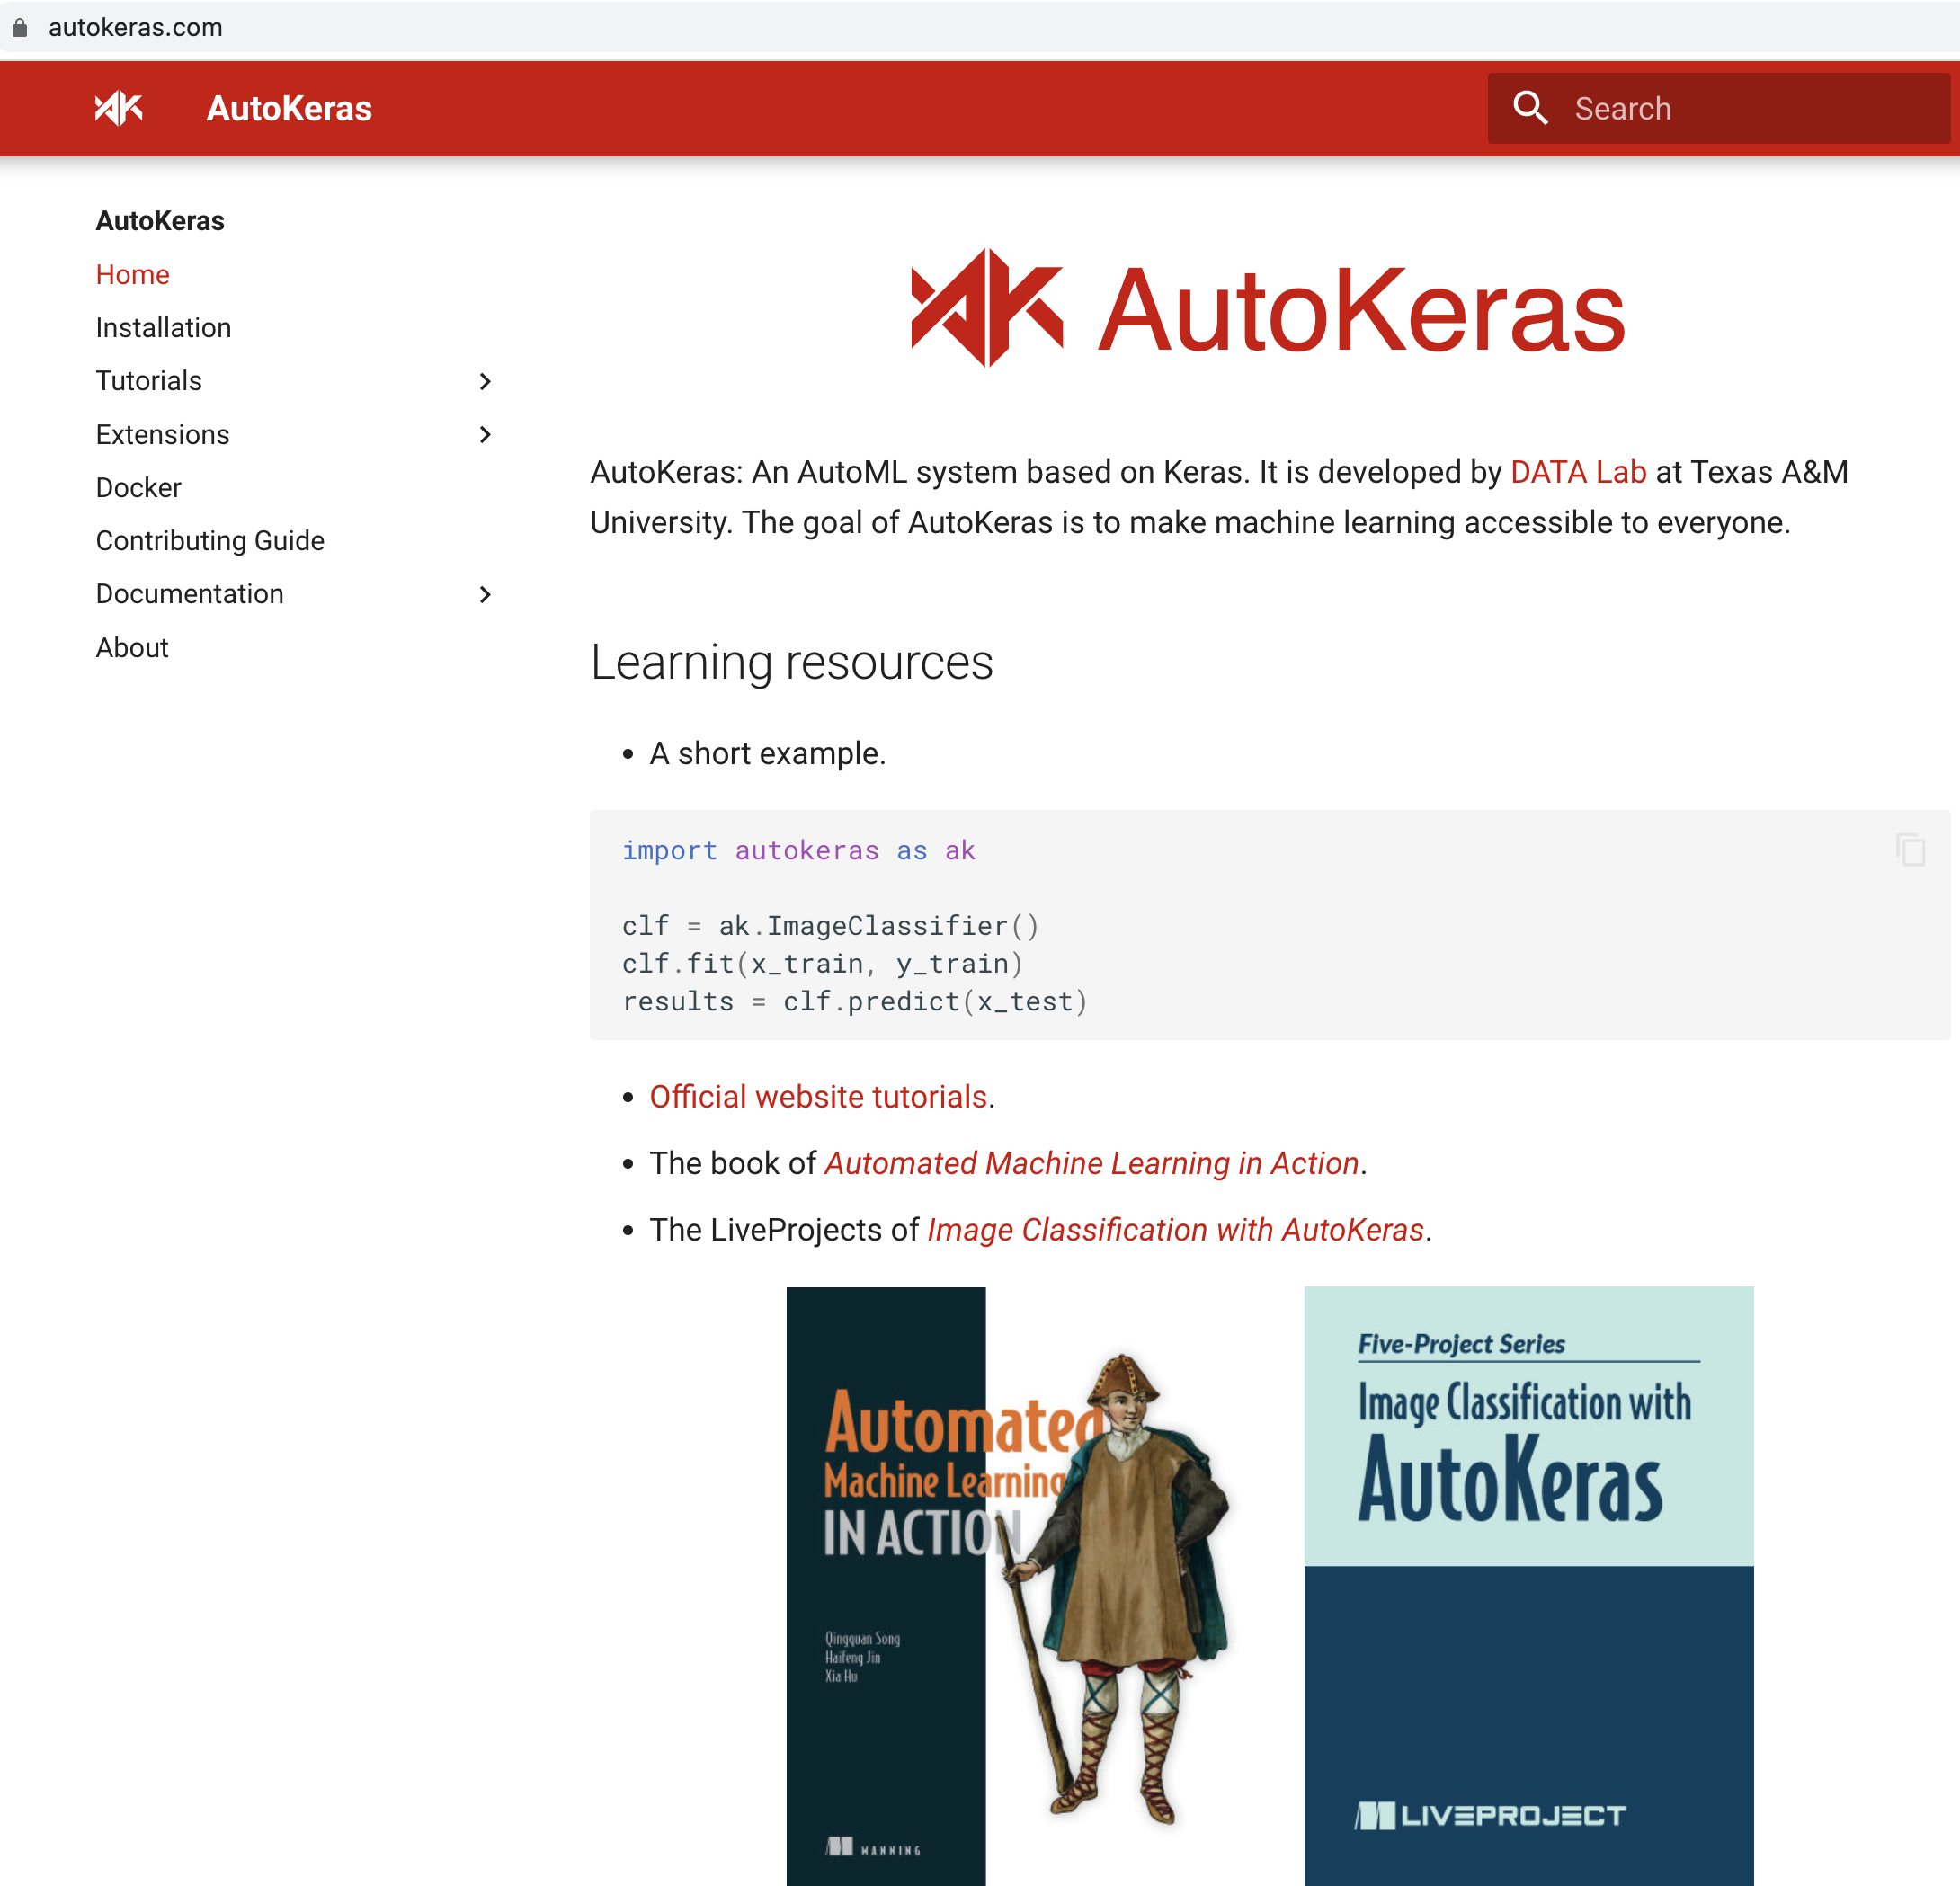

Slide 13
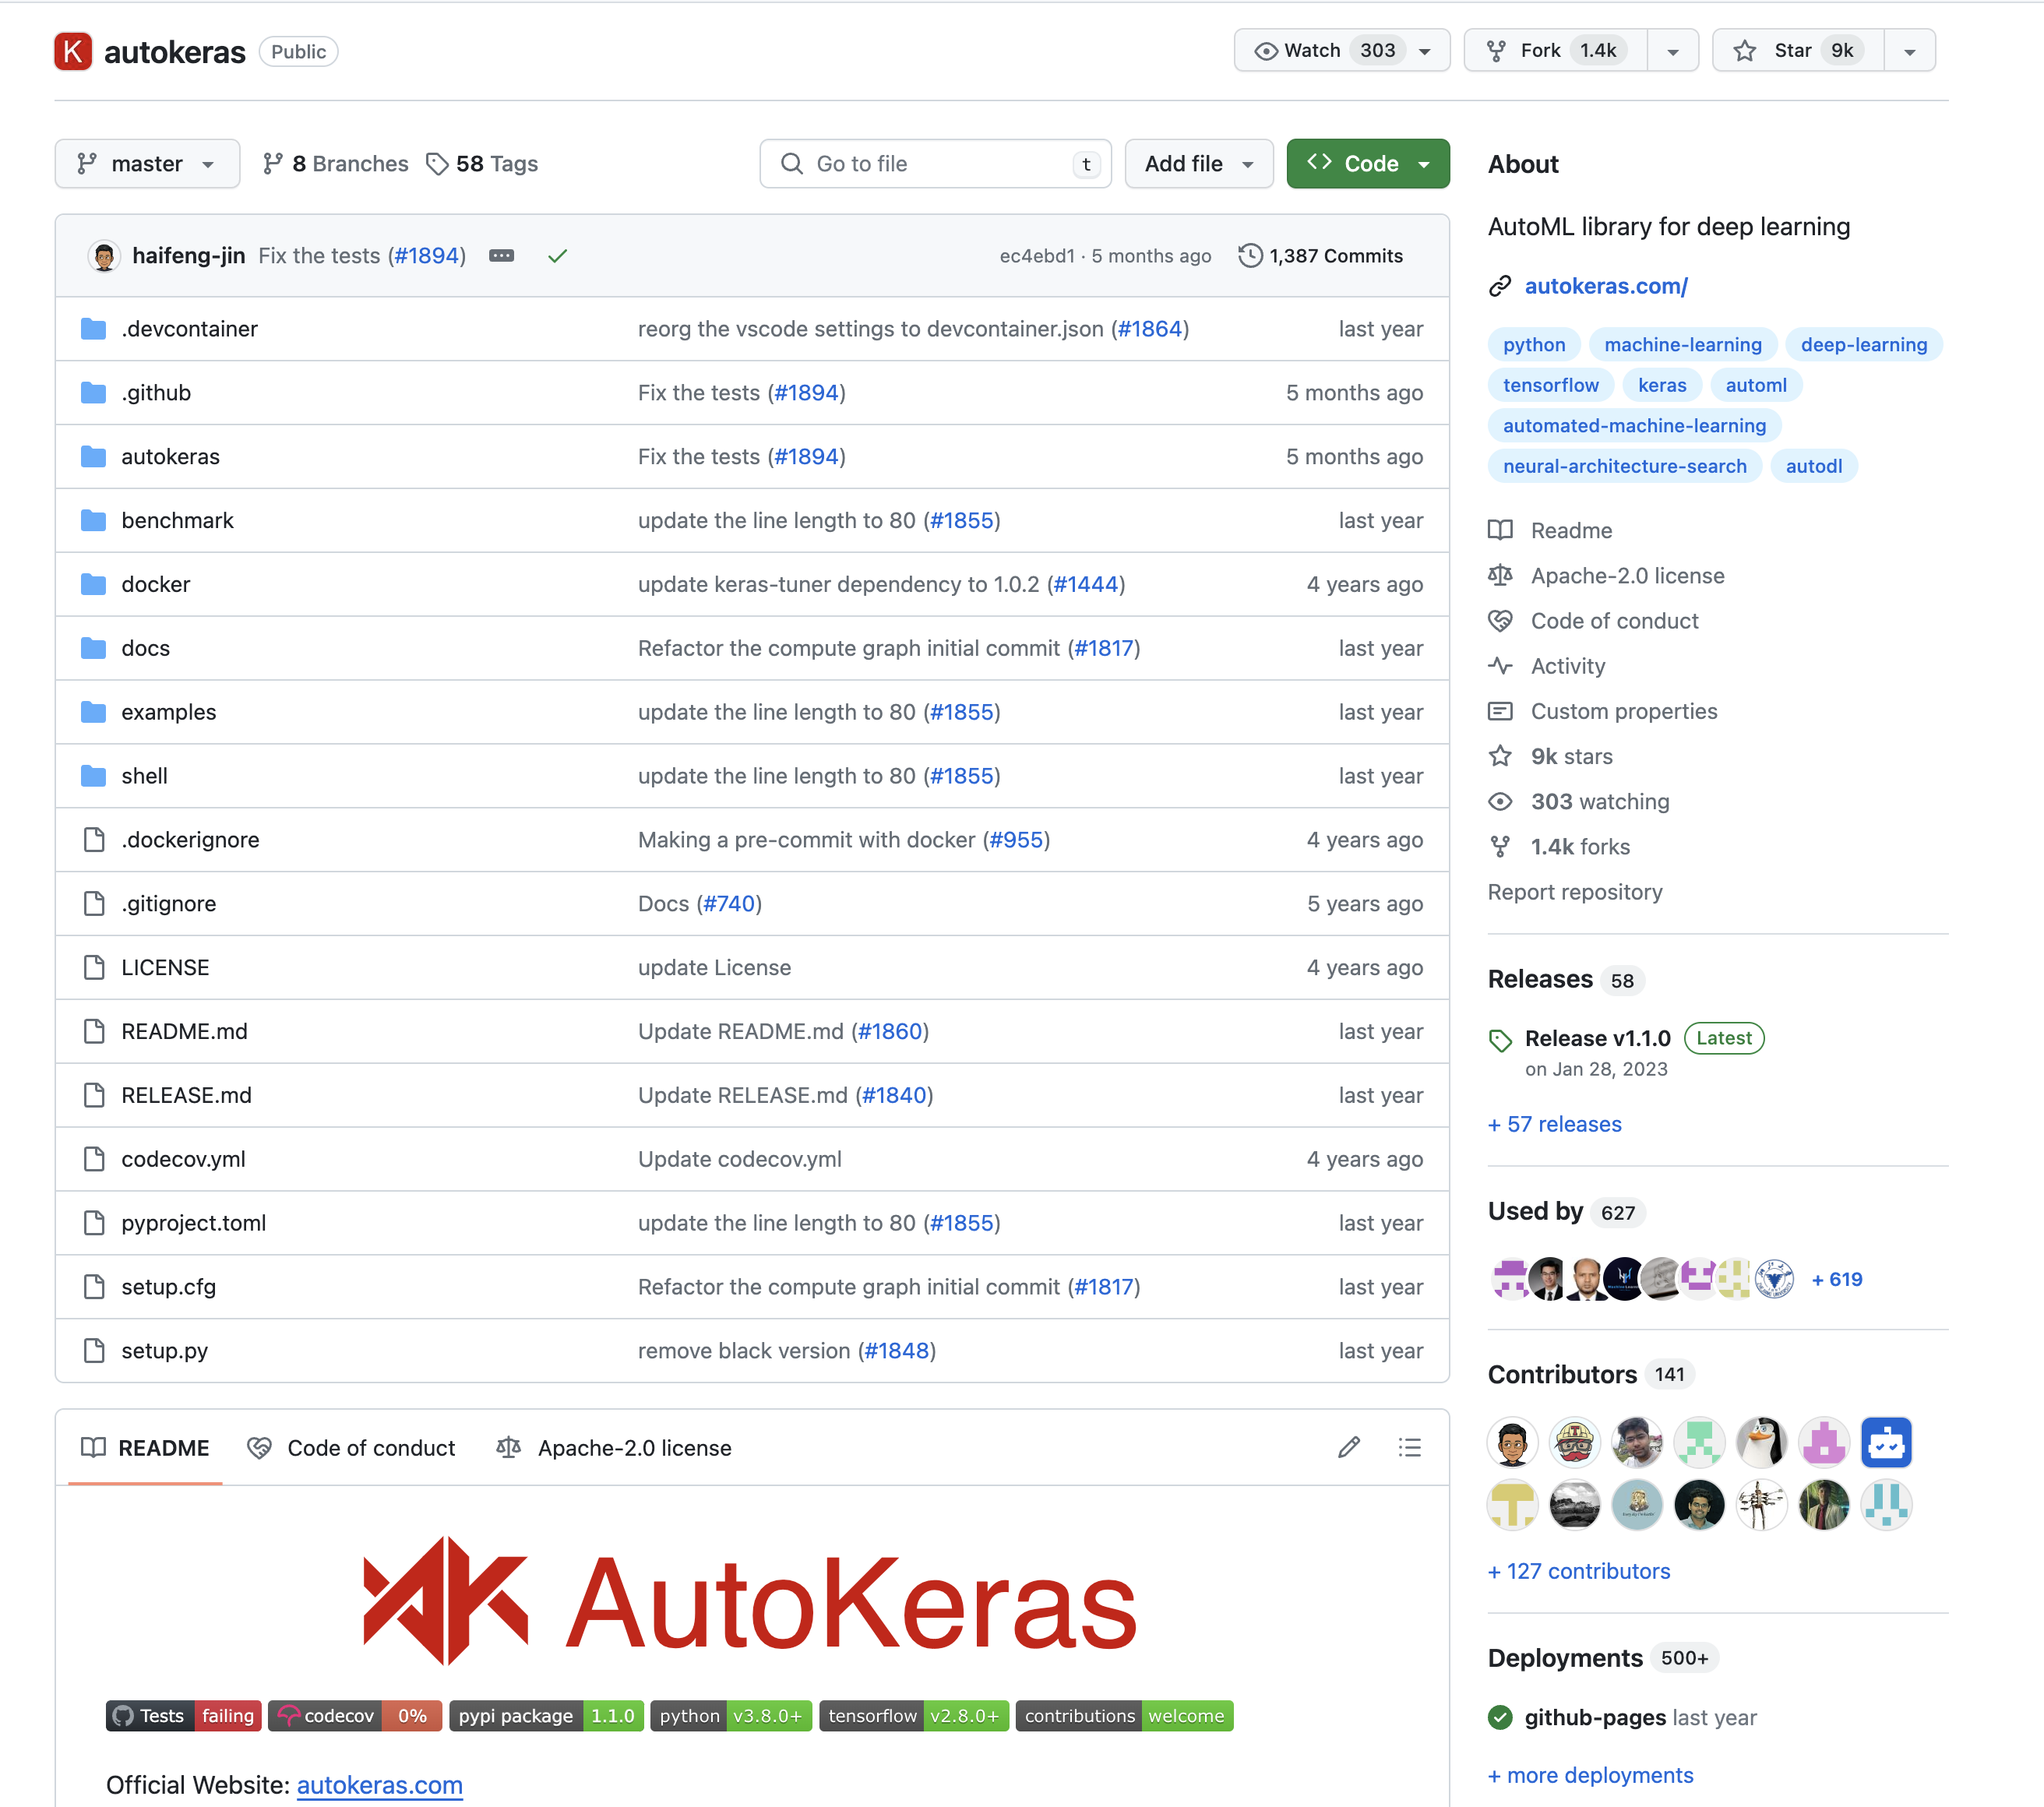

Slide 14
1
Substitute training stage with AutoML in Your pipeline (e.g. in Kedro)
2
Split Your training pipeline into 3 paths (PyCaret, AutoGluon, AutoKeras), running in different envs (docker?), and choose the best model
Ideas for Your projects
3
Compare training and inference speed of PyCaret, AutoGluon and AutoKeras
4
Compare them with Optuna/WandB hiperparam sweeps
5
Log AutoML params and metrics to WandB

